Slide 1

By: Rafael Diaz, Bruce Haskin, Amanda Grant

Slide 2
America’s number one marketing strategy.
Viral marketing is the most efficient way to advertise in today’s market. And with the confluence of users browsing the World Wide Web, companies are finding new ways of attracting and spreading their product messages.

Slide 3
The Aim
Viral marketing is the phenomenon that encourages the passage of the marketing message through people as the primary medium.
The goal is to demonstrate intrinsic value of the product to the user in the attempt for a purchase
In order for the ad to be successful it needs to be:
Entertaining
Useable
A Rewarding, or "Instant Gratification"
Unique, Original
Its main aim is to create a sense of usefulness amongst the individual users by establishing a sense of need or efficiency in the product.
Hotmail's web address of "Hotmail“ is one case scenario

Slide 4
So, what is viral marketing?
Essentially, viral marketing is a strategy of marketing that encourages users to spread along a marketing message.
Consumer
Consumer then passes the message on.
Consumer
Consumer then passes the message on.
Consumer
Consumer then passes the message on.
Advertiser

Slide 5
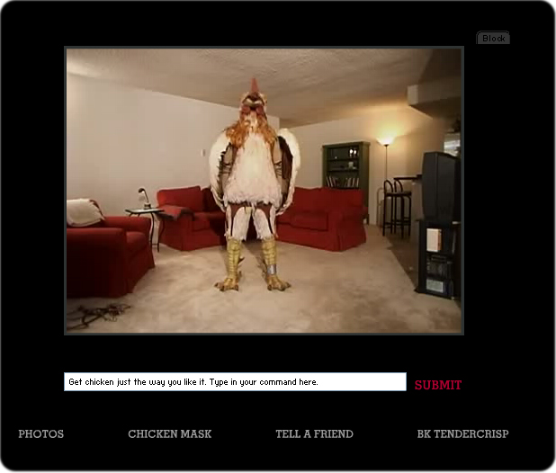
Burger King “The Subservient Chicken”
http://en.wikipedia.org/wiki/The_Subservient_Chicken
http://www.subservientchicken.com/

Slide 6
Order of the serpentine
http://orderoftheserpentine.com/subliminal.html

Slide 7
MySpace Advertising
http://www.entrepreneurs-journey.com/418/marketing-with-myspacecom/

Slide 8
In Video Games
Halo’s “I Love Bee’s”
Shadow Of The Colossus
http://www.gwgcats.com/
Personal Experience

